Slide 1
Automated NAV Calculation
Disclaimer: the purpose of this macro is to showcase my fundamental understanding of fund accounting and of macro automation to the prospective employers. By no means the macro as is can be/ should be utilized for professional use.
Vanipreet Saluja

Slide 2
NAV calculation process
For the calculation of NAV, multiple sub-processes are conducted first
Securities Position- It is a process to list out current holding of securities under fund with subsequent quantities
Cash Position- It is a process of calculating net cash available on the fund
Fund Pricing- It is a process of updating EOD prices of securities under a given fund
Liabilities calculation- It is a process to calculate total liabilities on a fund

Slide 3
Inputs for NAV calculation
For individual process, following inputs are utilized
Securities Position
Current holdings
Transactions list
Cash Position
Current cash
Transactions list
Fund Pricing
Updated Securities position
EOD Prices
Liabilities Calculation
List of liabilities

Slide 4
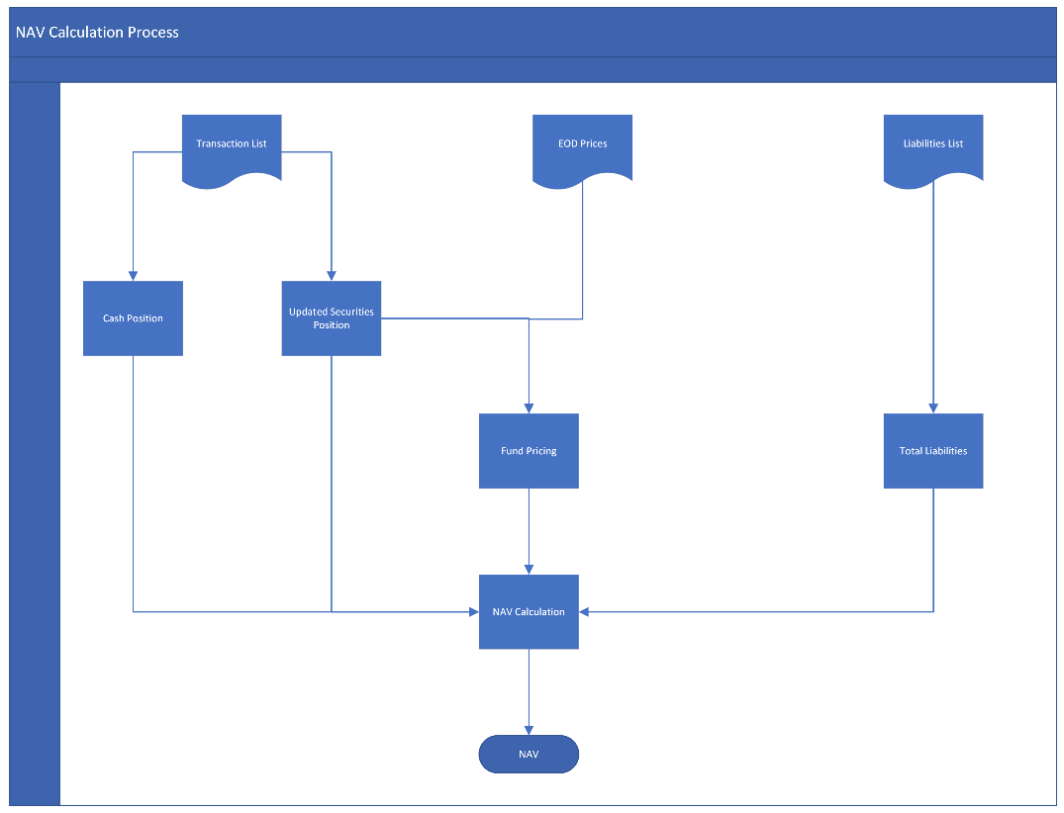
Flowchart of NAV Calculation Process

Slide 5
Demonstration of Macro

Slide 6
Thank You

